Slide 1
Introduction to Machine Learning and Data Mining
by
Shangsong Liang (梁上松)
School of Computer Science and Engineering
Sun Yat-sen University
Notes:
Some slides were produced by Tan, Steinbach, Karpatne, Kumar, mantra, Eric Eaton@University of Pennsylvania
Jure Leskovec@Stanford University
slightly modified by S Liang. Do not redistributed.

Slide 2
Introduce Myself
Associate Professor
  School of Computer Science and Engineering
  2018/10—present
PhD
  University of Amsterdam
Notes:
Slides were produced by Tan, Steinbach, Karpatne, Kumar, slightly modified by S Liang. Do not redistributed.

Slide 3
Grading
Final exam: ~40%
Homeworks/Others: ~60%, including assignments and attendance record
Notes:
Slides were produced by Tan, Steinbach, Karpatne, Kumar, slightly modified by S Liang. Do not redistributed.

Slide 4

QQ Group ID: 859899058
Message for joining into the group: 中山大学
http://cse.sysu.edu.cn/content/4569
My Email: liangshs5@mail.sysu.edu.cn

Slide 5

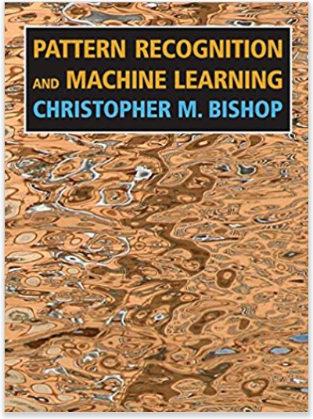
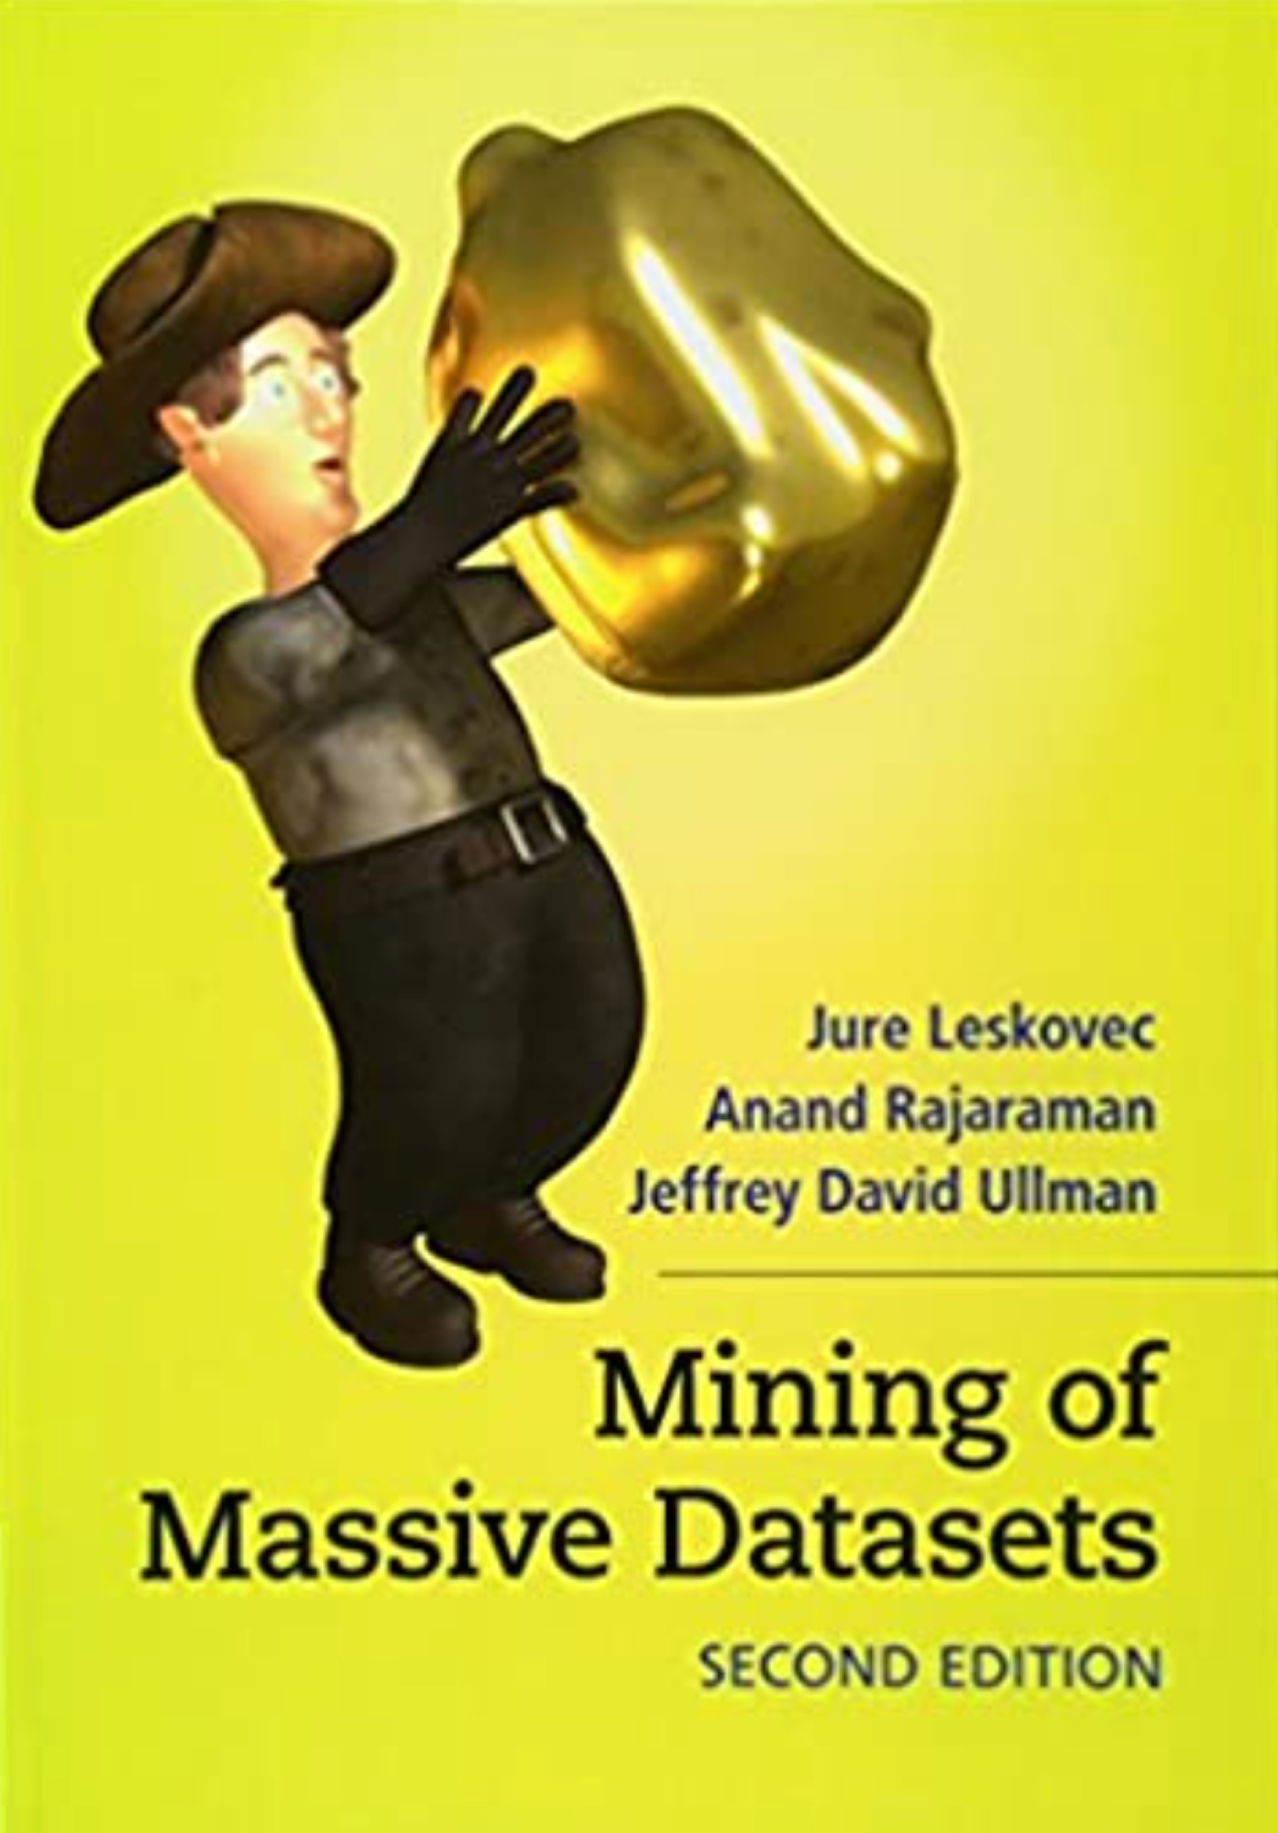
Textbooks
《机器学习》, 周志华主编，清华大学出版社
Pattern Recognition and Machine Learning, Christopher. M. Bishop, Springer
Mining of Massive Datasets, Leskovec, Rajaraman, Ullman, Cambridge University Press￼￼
Notes:
Slides were produced by Tan, Steinbach, Karpatne, Kumar, slightly modified by S Liang. Do not redistributed.

Slide 6
Online Materials
Stanford machine learning course
– https://cs229.stanford.edu/
– Some additional notes for reading: https://cs229.stanford.edu/main_notes.pdf
Stanford data mining course
– https://web.stanford.edu/class/cs246/
Machine learning competitions – http://www.kaggle.com
Wikipedia
Blogs

Slide 7
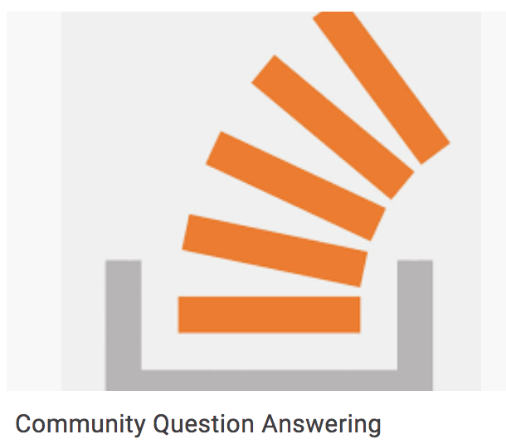



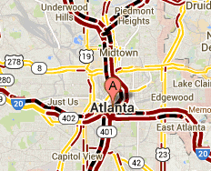
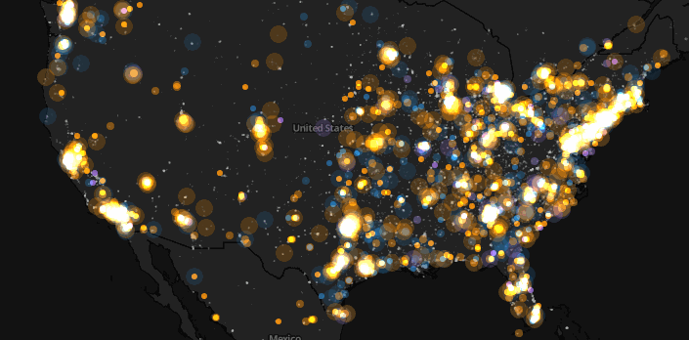
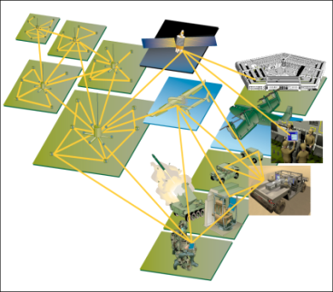
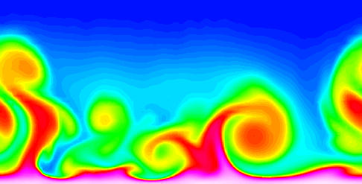
Large-scale Data is Everywhere!
There has been enormous data growth in both commercial and scientific databases due to advances in data generation and collection technologies
New mantra
  Gather whatever data you can whenever and wherever possible.
Expectations
  Gathered data will have value either for the purpose collected or for a purpose not envisioned.
Community Question Answering
E-Commerce
Traffic Patterns
Social Networking: Twitter
Sensor Networks
Computational Simulations

Slide 8




Why Data Mining? Commercial Viewpoint
Lots of data is being collected
and warehoused
  Web data
    Yahoo has Peta Bytes of web data
    Facebook has billions of active users
  purchases at department/
  grocery stores, e-commerce
    Amazon handles millions of visits/day
  Bank/Credit Card transactions
Computers have become cheaper and more powerful
Competitive Pressure is Strong
  Provide better, customized services for an edge (e.g. in Customer Relationship Management)

Slide 9
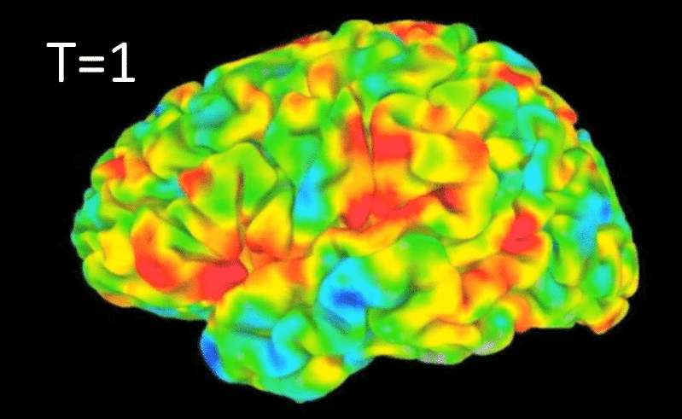
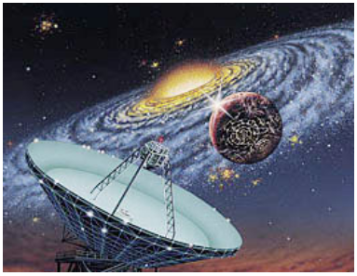
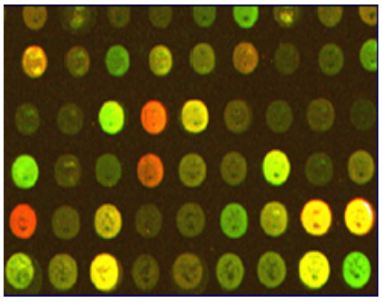
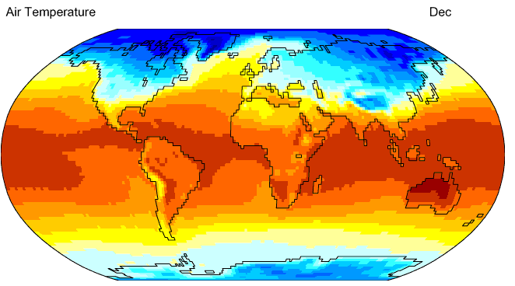
Why Data Mining? Scientific Viewpoint
Data collected and stored at
enormous speeds
  remote sensors on a satellite
    NASA EOSDIS archives over
    petabytes of earth science data / year
  telescopes scanning the skies
    Sky survey data
  High-throughput biological data
  scientific simulations
    terabytes of data generated in a few hours
Data mining helps scientists
  in automated analysis of massive datasets
  In hypothesis formation
fMRI Data from Brain
Sky Survey Data
Gene Expression Data
Surface Temperature of Earth

Slide 10
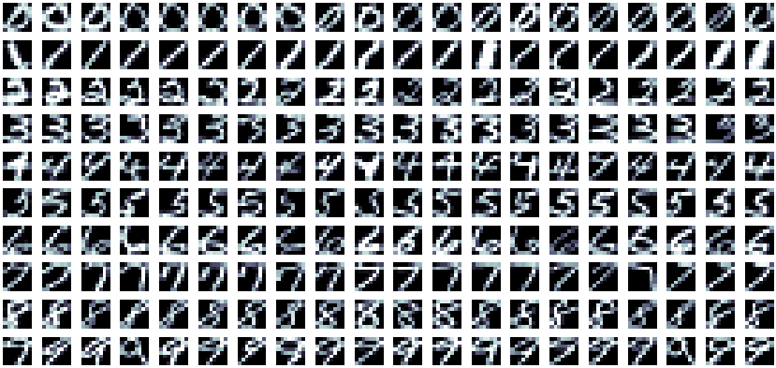
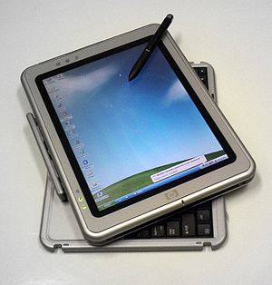

Why Data Mining? Scientific Viewpoint
Hand-written character recognition
Face recognition -- iphone X face ID, to unlock your device and authorize payments.
Tablet
Xiangliang Zhang, KAUST CS 340: Data Mining

Slide 11
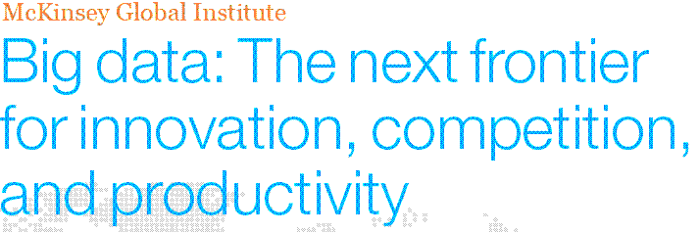
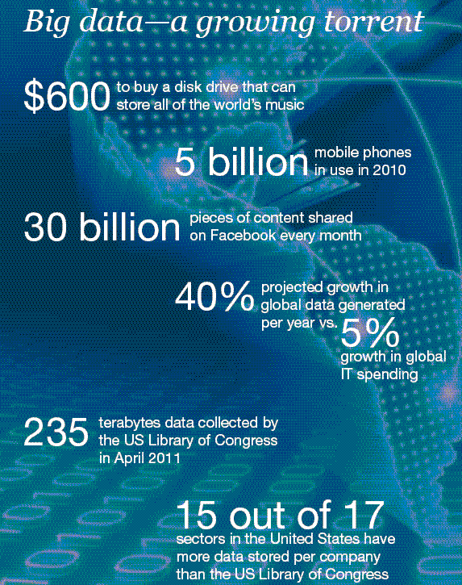
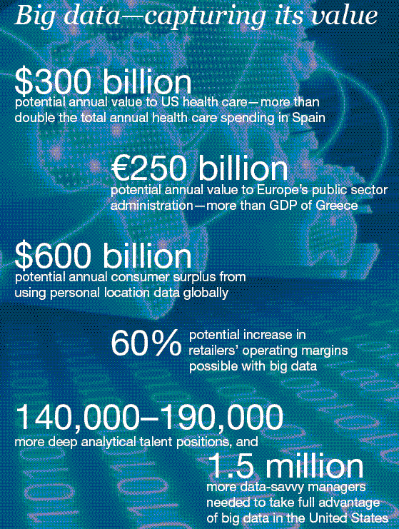
Great opportunities to improve productivity in all walks of life

Slide 12
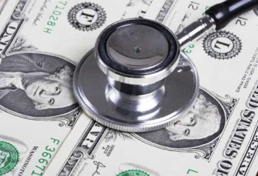
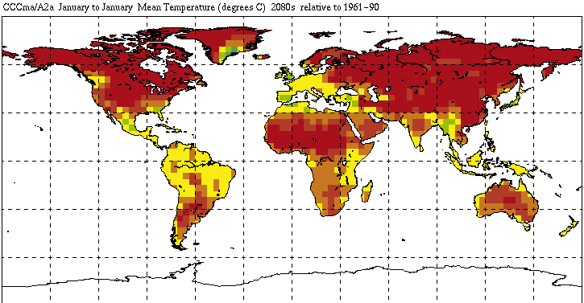
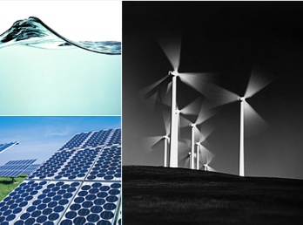
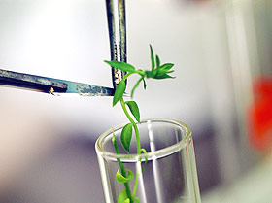
Great Opportunities to Solve Society’s Major Problems
Improving health care and reducing costs
Predicting the impact of climate change
Finding alternative/ green energy sources
Reducing hunger and poverty by
increasing agriculture production

Slide 13

What is Data Mining?
Data mining is the process of discovering unknown/new patterns from large data sets involving methods from statistics and artificial intelligence but also database management.

Slide 14
What is Machine Learning?
Machine learning (ML) is the study of computer algorithms that improve automatically through experience.^{[1][2]} It is seen as a subset of artificial intelligence. Machine learning algorithms build a mathematical model based on sample data, known as "training data", in order to make predictions or decisions without being explicitly programmed to do so.

Slide 15
What is Machine Learning?
Machine learning (ML) algorithms are used in a wide variety of applications, such as email filtering and computer vision, where it is difficult or infeasible to develop conventional algorithms to perform the needed tasks.

Slide 16
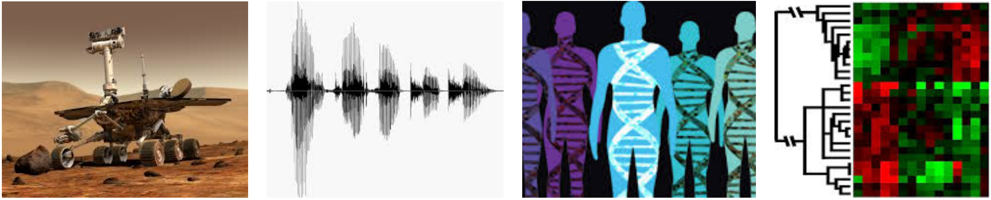
When Do We Use Machine Learning?
ML is used when:
Human expertise does not exist (navigating on Mars)
Humans can’t explain their expertise (speech recognition)
Models must be customized (personalized medicine)
Models are based on huge amounts of data (genomics)
Learning isn’t always useful:
There is no need to “learn” to calculate payroll
DCS310 @ SYSU

Slide 17
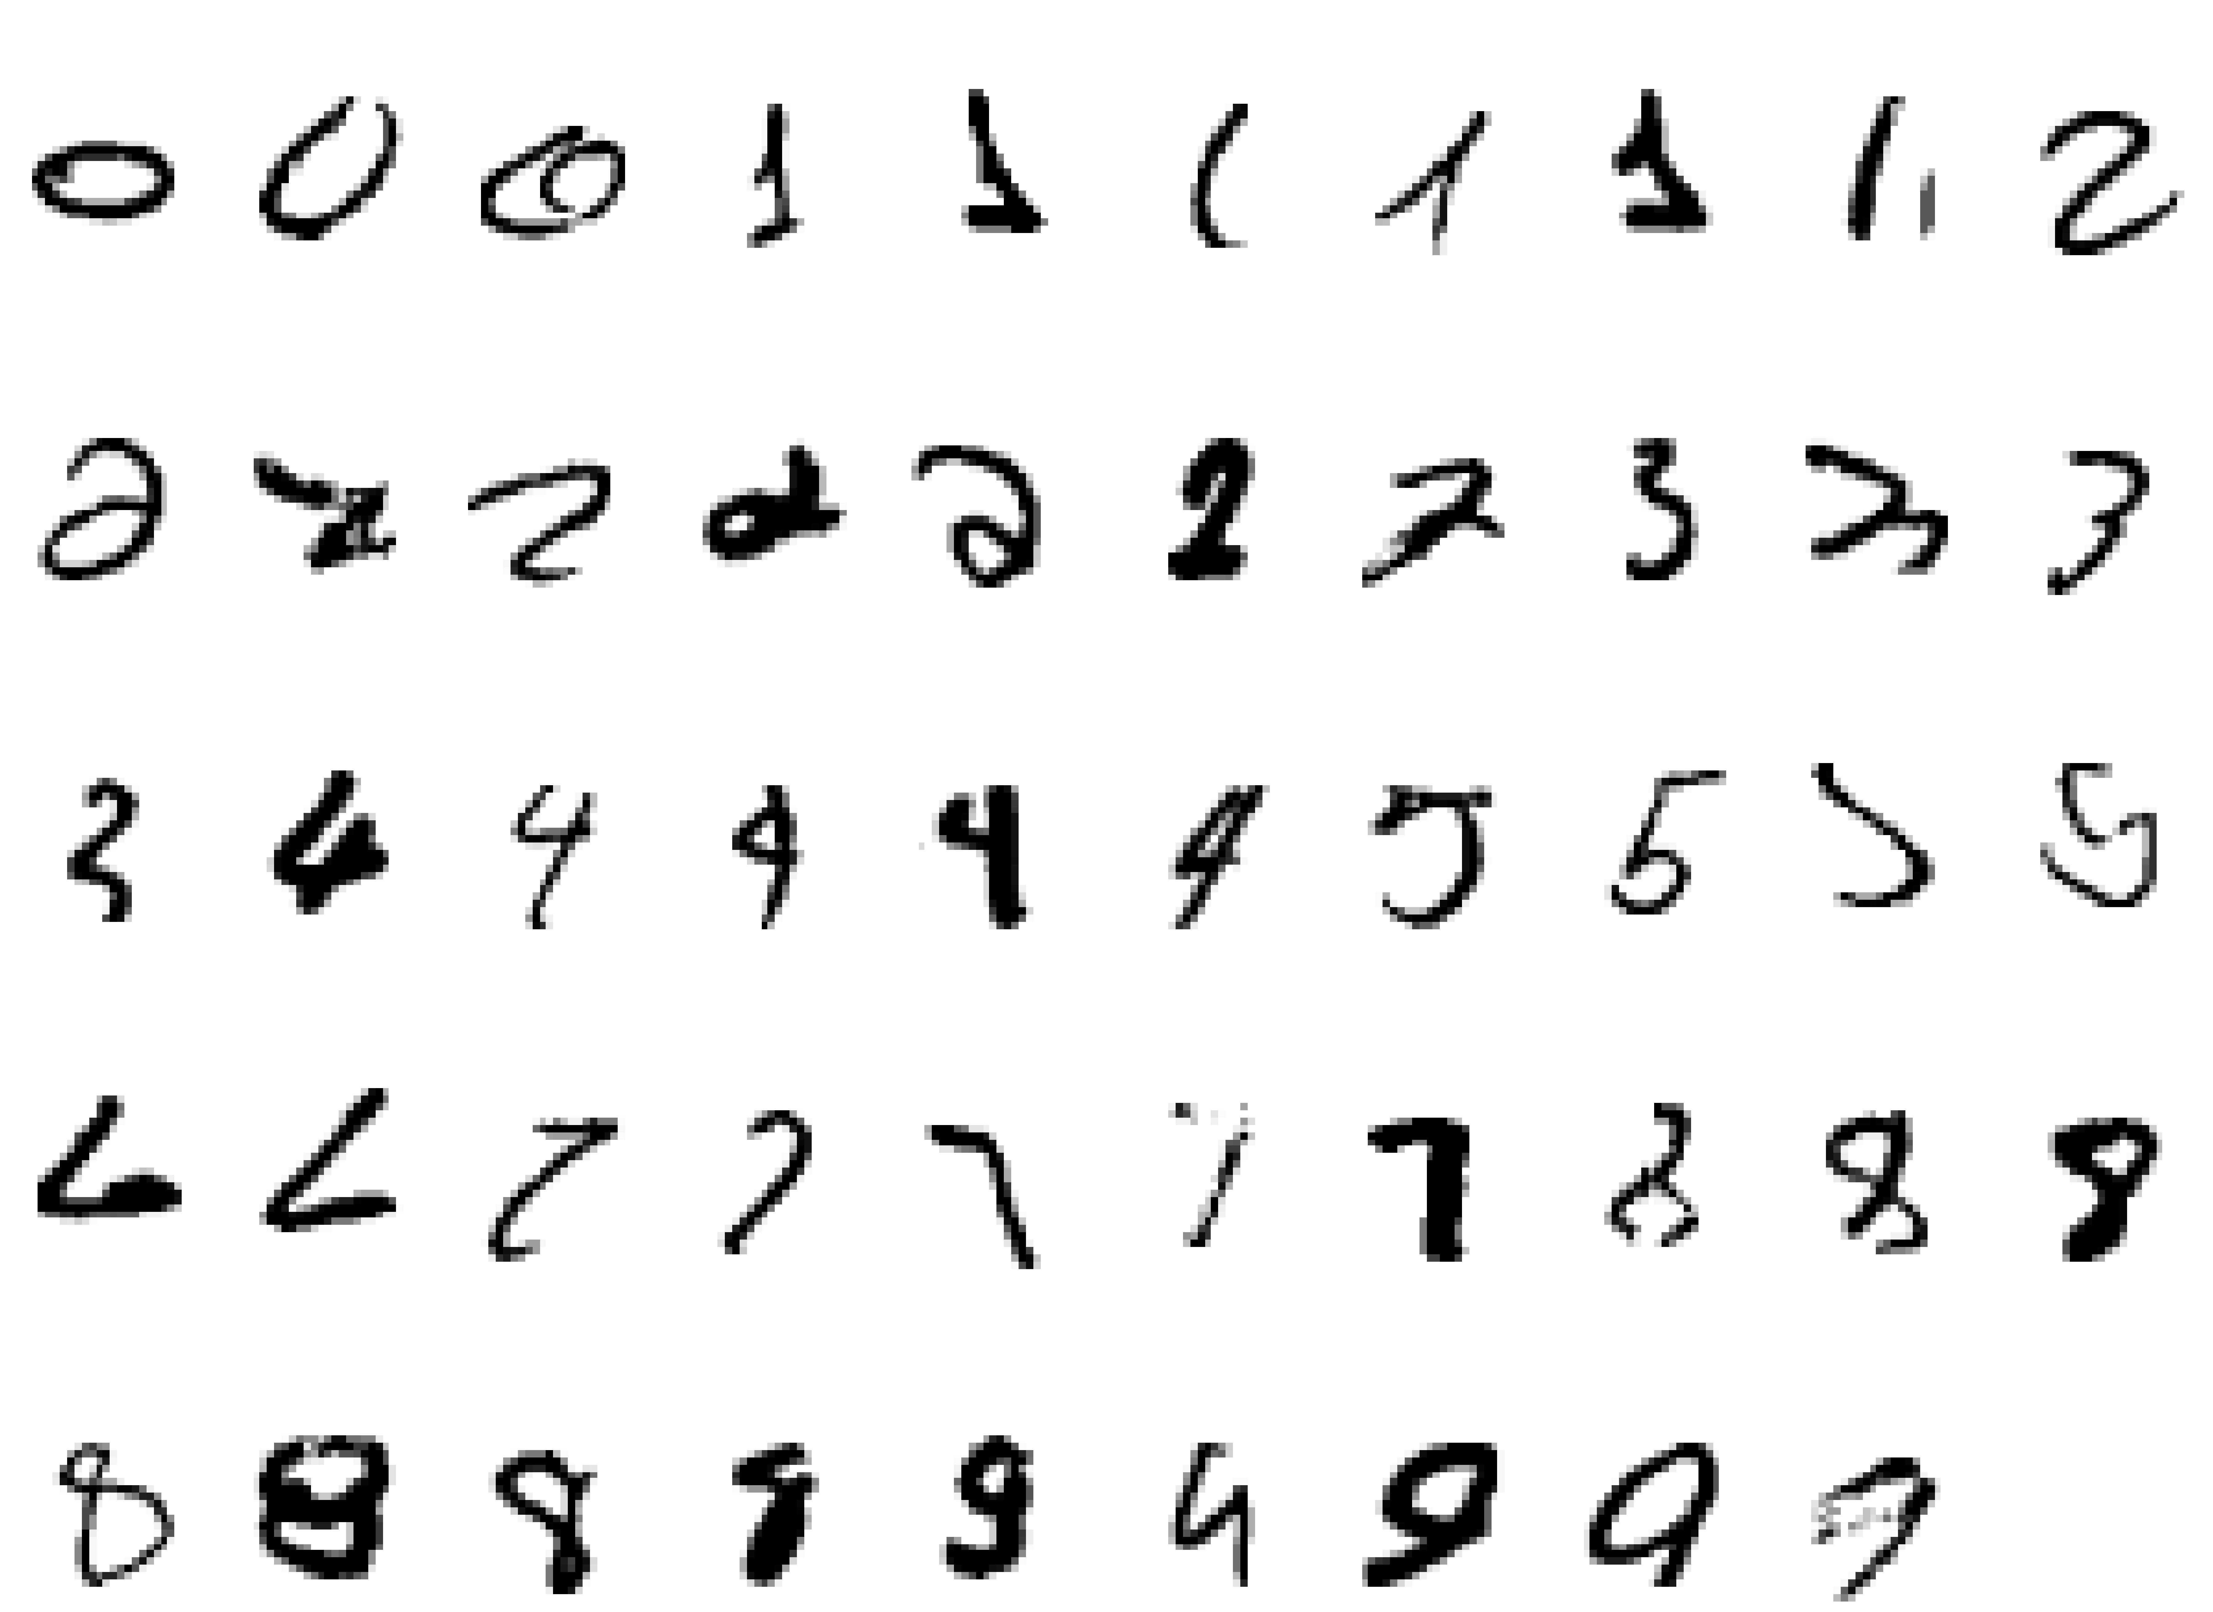
A classic example of a task that requires machine learning:
It is very hard to say what makes a 2
DCS310 @ SYSU

Slide 18
Some more examples of tasks that are best solved by using a learning algorithm
  Recognizing patterns:
  - Facial identities or facial expressions
  - Handwritten or spoken words
  - Medical images
  Generating patterns:
  - Generating images or motion sequences
  Recognizing anomalies:
  - Unusual credit card transactions
  - Unusual patterns of sensor readings in a nuclear power plant
  Prediction:
  - Future stock prices or currency exchange rates

Slide 19
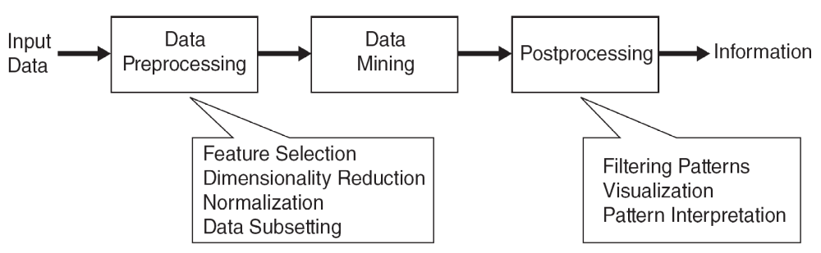
What is Data Mining?
Many Definitions
  Non-trivial extraction of implicit, previously unknown and potentially useful information from data
  Exploration & analysis, by automatic or semi-automatic means, of large quantities of data in order to discover
  meaningful patterns

Slide 20
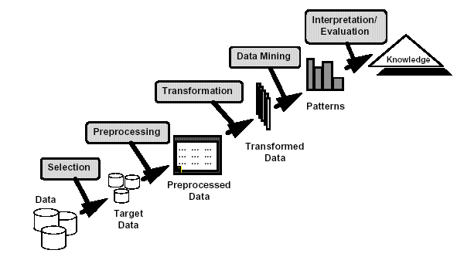
What is Data Mining?
Many definitions:
Non-trivial extraction of implicit, previously unknown and potentially useful information from data
Exploration & analysis, by automatic or
semi-automatic means, of
large quantities of data
in order to discover
meaningful patterns
Book: Introduction to Data Mining. Tan, Steinbach, Kumar

Slide 21
Meaningful Patterns
Process of semi-automatically/automatically analyzing large databases to find patterns that are:
valid: hold on new data with some certainty
novel: non‐obvious to the system
useful: should be possible to act on the item
understandable: humans should be able to interpret the pattern

Slide 22
What is (not) Data Mining?
What is not Data Mining?
  Look up phone number in phone directory
  ?
What is Data Mining?
  Certain names are more prevalent in certain US locations (O’Brien, O’Rourke, O’Reilly… in Boston area)
  Group together similar documents returned by search engine according to their context (e.g., Amazon rainforest, Amazon.com)

Slide 23
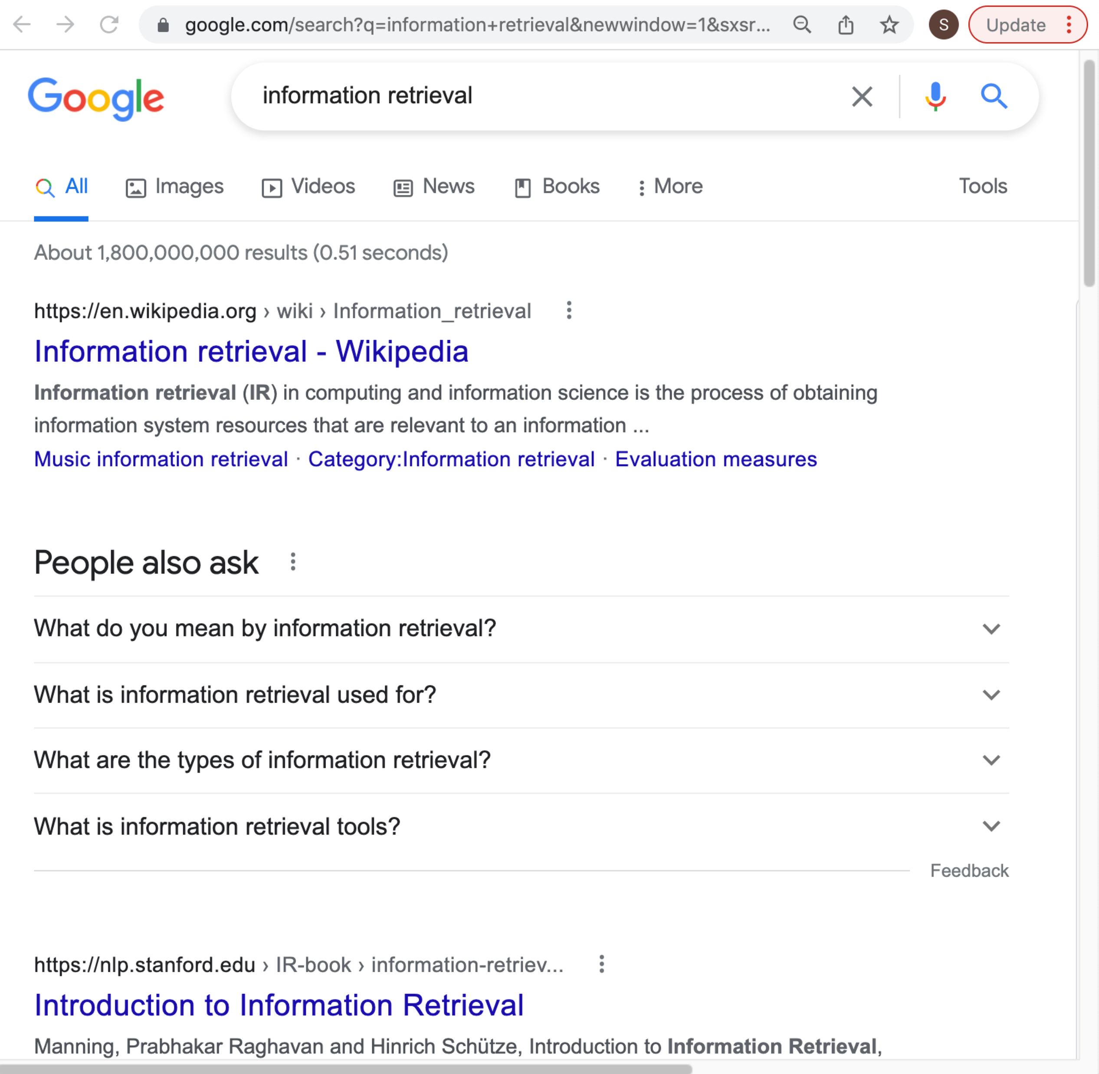
Data Mining and new IT technology
Information retrieval

Slide 24
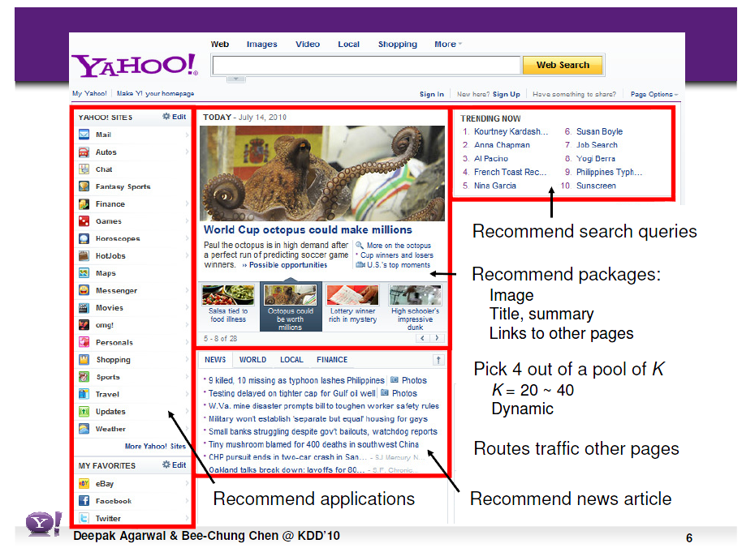
Data Mining and new IT technology
Recommendation systems

Slide 25
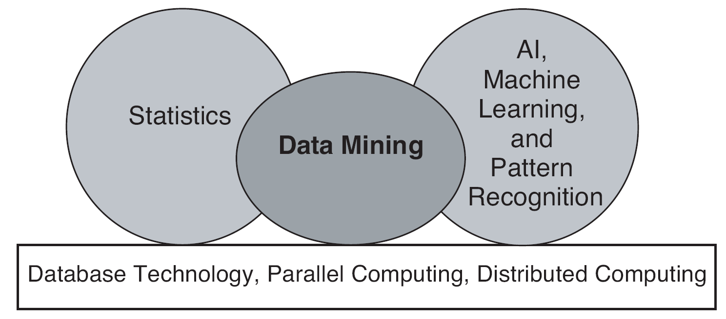
Origins of Data Mining
Draws ideas from machine learning/AI, pattern recognition, statistics, and database systems
Traditional techniques may be unsuitable due to data that is
  Large-scale
  High dimensional
  Heterogeneous
  Complex
  Distributed
A key component of the emerging field of data science and data-driven discovery

Slide 26
Data Mining Tasks
Prediction Methods
  Use some variables to predict unknown or future values of other variables.
Description Methods
  Find human-interpretable patterns that describe the data.
From [Fayyad, et.al.] Advances in Knowledge Discovery and Data Mining, 1996

Slide 27
Data Mining Tasks...
Classification [Predictive]
Clustering [Descriptive]
Association Rule Discovery [Descriptive]
Sequential Pattern Discovery [Descriptive]
Regression [Predictive]
Anomaly Detection (异常检测) [Predictive]
Etc.

Slide 28
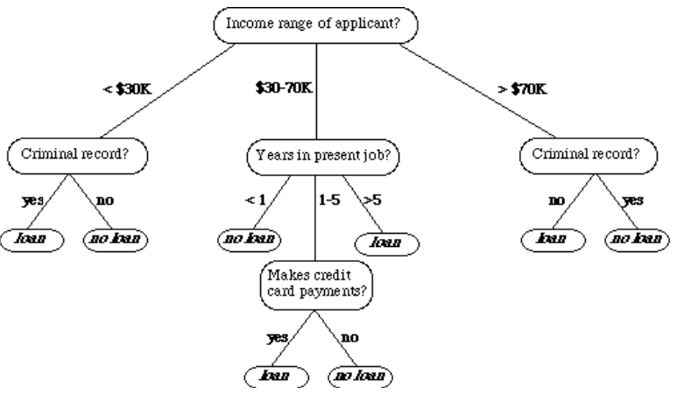
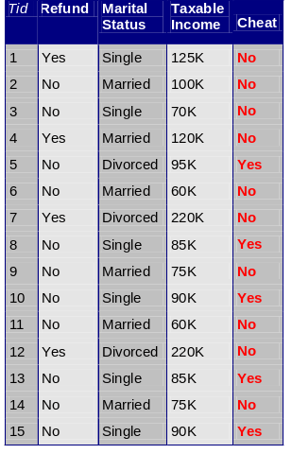



Data Mining Tasks …
Data
Clustering
Predictive Modeling
Association
Rules
Anomaly
Detection
Milk

Slide 29
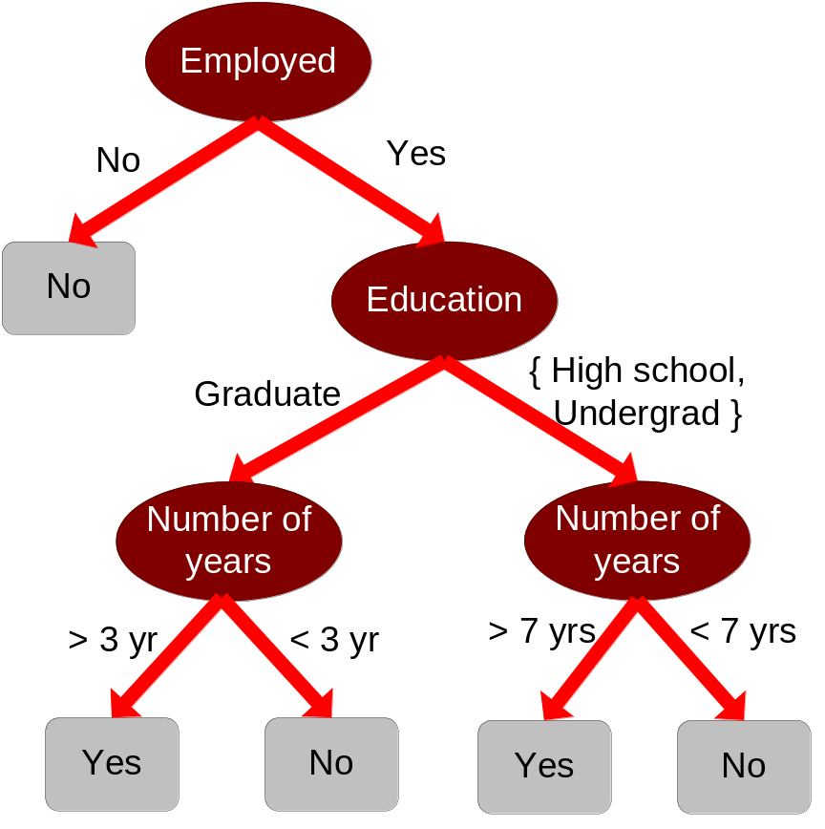
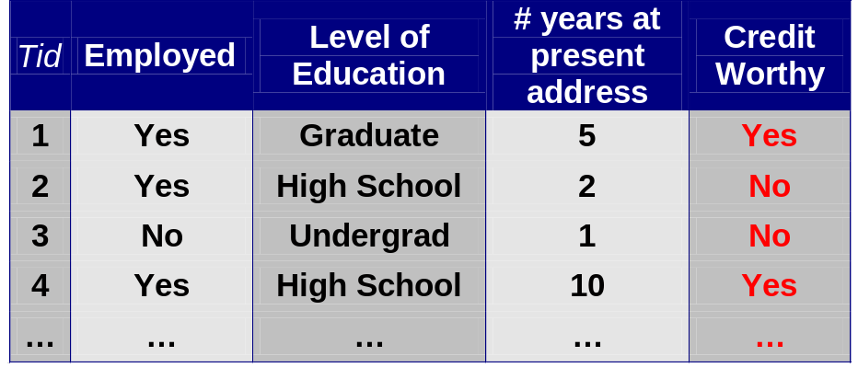
Predictive Modeling: Classification
Find a model for class attribute as a function of the values of other attributes
Model for predicting credit worthiness
Class

Slide 30
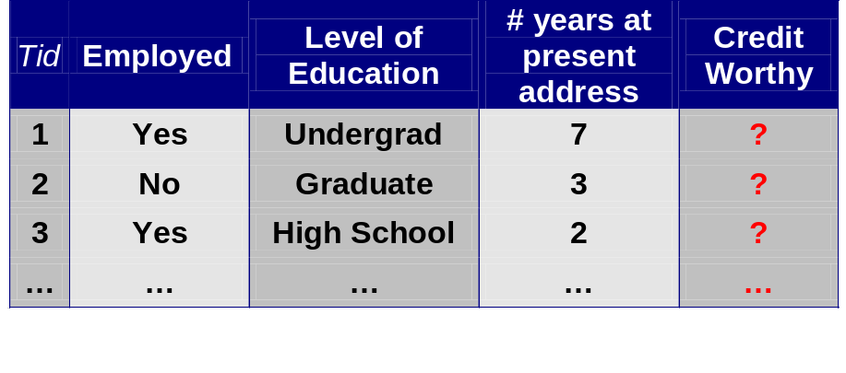
Classification Example
categorical
quantitative
categorical
class
Test
Set
Learn
Classifier
Training
Set
Model

Slide 31
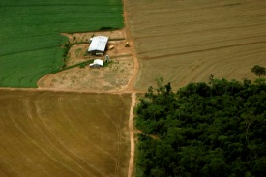

Examples of Classification Task
Classifying credit card transactions
as legitimate or fraudulent
Classifying land covers (water bodies, urban areas, forests, etc.) using satellite data
Categorizing news stories as finance,
weather, entertainment, sports, etc
Identifying intruders (入侵) in the cyberspace
Predicting tumor cells as benign or malignant
Classifying secondary structures of protein
as alpha-helix, beta-sheet, or random coil

Slide 32
Classification: Application 1
Fraud Detection
  Goal: Predict fraudulent cases in credit card transactions.
  Approach:
    Use credit card transactions and the information on its account-holder as attributes.
      When does a customer buy, what does he buy, how often he pays on time, etc
    Label past transactions as fraud or fair transactions. This forms the class attribute.
    Learn a model for the class of the transactions.
    Use this model to detect fraud by observing credit card transactions on an account.

Slide 33
Classification: Application 2
Churn prediction for telephone customers
  Goal: To predict whether a customer is likely to be lost to a competitor.
  Approach:
    Use detailed record of transactions with each of the past and present customers, to find attributes.
      How often the customer calls, where he calls, what time-of-the day he calls most, his financial status, marital status, etc.
    Label the customers as loyal or disloyal.
    Find a model for loyalty.
From [Berry & Linoff] Data Mining Techniques, 1997

Slide 34
Classification: Application 3
Sky Survey Cataloging
  Goal: To predict class (star or galaxy) of sky objects, especially visually faint ones, based on the telescopic survey images (from Palomar Observatory).
      3000 images with 23,040 x 23,040 pixels per image.
  Approach:
    Segment the image.
    Measure image attributes (features) - 40 of them per object.
    Model the class based on these features.
    Success Story: Could find 16 new high red-shift quasars, some of the farthest objects that are difficult to find!
From [Fayyad, et.al.] Advances in Knowledge Discovery and Data Mining, 1996

Slide 35



Classifying Galaxies
Courtesy: http://aps.umn.edu
Early
Class:
Stages of Formation
Attributes:
Image features,
Characteristics of light waves received, etc.
Intermediate
Late
Data Size:
72 million stars, 20 million galaxies
Object Catalog: 9 GB
Image Database: 150 GB

Slide 36
Regression
Predict a value of a given continuous valued variable based on the values of other variables, assuming a linear or nonlinear model of dependency.
Extensively studied in statistics, neural network fields.
Examples:
  Predicting sales amounts of new product based on advetising expenditure.
  Predicting wind velocities as a function of temperature, humidity, air pressure, etc.
  Time series prediction of stock market indices.

Slide 37
Clustering
Finding groups of objects such that the objects in a group will be similar (or related) to one another and different from (or unrelated to) the objects in other groups
Inter-cluster distances are maximized
Intra-cluster distances are minimized

Slide 38
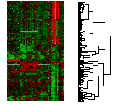
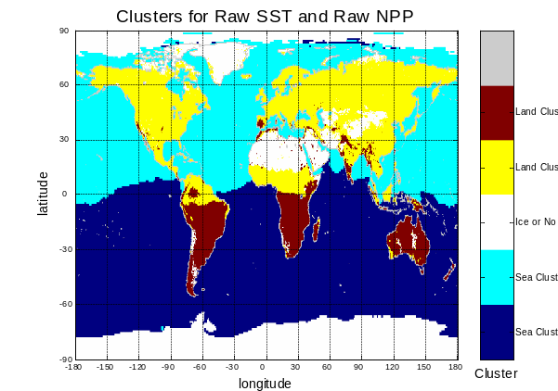
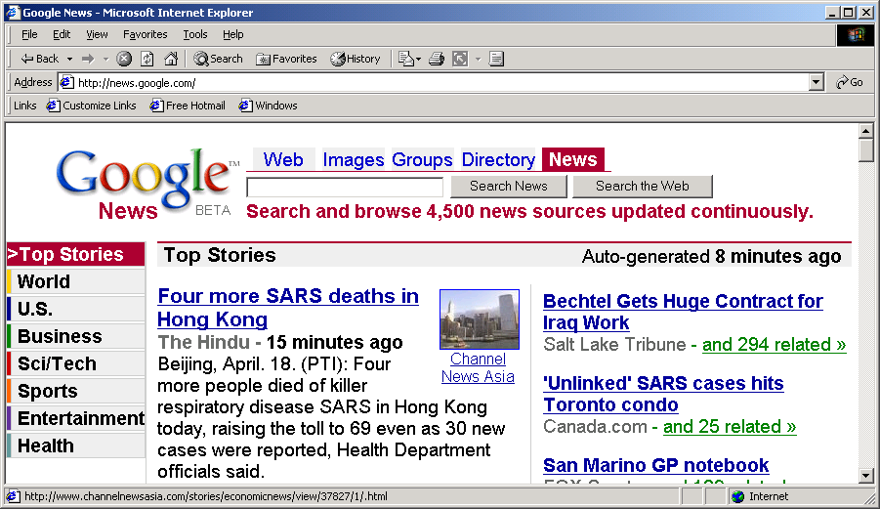
Applications of Cluster Analysis
Understanding
  Custom profiling for targeted marketing
  Group related documents for browsing
  Group genes and proteins that have similar functionality
  Group stocks with similar price fluctuations
Summarization
  Reduce the size of large data sets
Courtesy: Michael Eisen
Use of K-means to partition Sea Surface Temperature (SST) and Net Primary Production (NPP) into clusters that reflect the Northern and Southern Hemispheres.
01/17/2018

Slide 39
Clustering: Application 1
Market Segmentation:
  Goal: subdivide a market into distinct subsets of customers where any subset may conceivably be selected as a market target to be reached with a distinct marketing mix.
  Approach:
    Collect different attributes of customers based on their geographical and lifestyle related information.
    Find clusters of similar customers.
    Measure the clustering quality by observing buying patterns of customers in same cluster vs. those from different clusters.

Slide 40
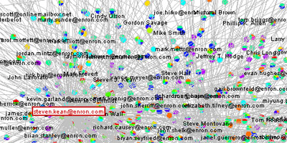
Clustering: Application 2
Document Clustering:
  Goal: To find groups of documents that are similar to each other based on the important terms appearing in them.
  Approach: To identify frequently occurring terms in each document. Form a similarity measure based on the frequencies of different terms. Use it to cluster.
Enron email dataset

Slide 41

Association Rule Discovery: Definition
Given a set of records each of which contain some number of items from a given collection
  Produce dependency rules which will predict occurrence of an item based on occurrences of other items.
Rules Discovered:
{Milk} --> {Coke}
{Diaper, Milk} --> {Beer}

Slide 42
Association Analysis: Applications
Market-basket analysis
  Rules are used for sales promotion, shelf management, and inventory management
Telecommunication alarm diagnosis
  Rules are used to find combination of alarms that occur together frequently in the same time period
Medical Informatics
  Rules are used to find combination of patient symptoms and test results associated with certain diseases

Slide 43
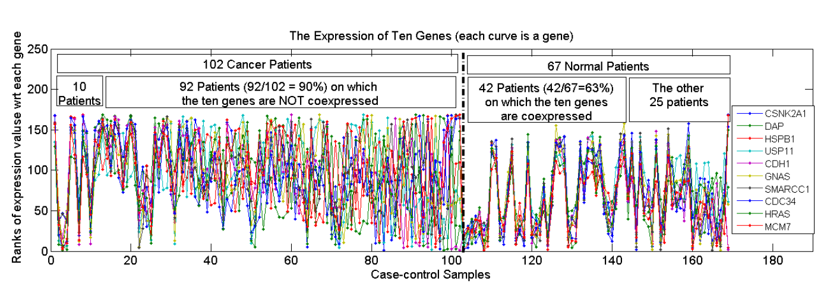
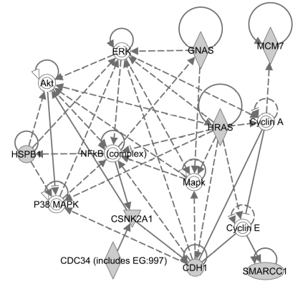
Association Analysis: Applications
An Example Subspace Differential Coexpression Pattern from lung cancer dataset
Enriched with the TNF/NFB signaling pathway
which is well-known to be related to lung cancer
P-value: 1.4*10⁻⁵ (6/10 overlap with the pathway)
  Three lung cancer datasets [Bhattacharjee et al. 2001], [Stearman et al. 2005], [Su et al. 2007]
[Fang et al PSB 2010]

Slide 44

Deviation/Anomaly/Change Detection
Detect significant deviations from normal behavior
Applications:
  Credit Card Fraud Detection
  Network Intrusion
  Detection
  Identify anomalous behavior from sensor networks for monitoring and surveillance.
  Detecting changes in the global forest cover.

Slide 45
State of the Art Applications of Machine Learning
DCS310 @ SYSU

Slide 46
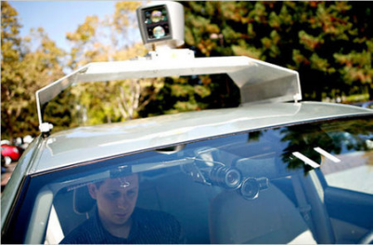
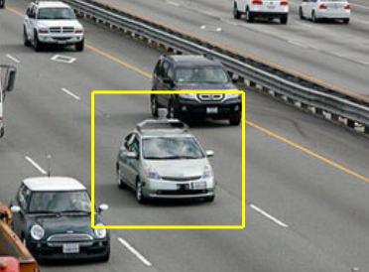
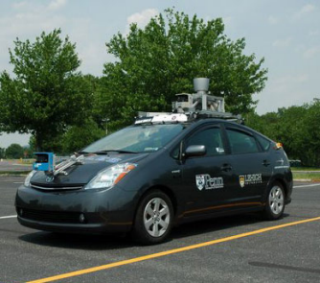
Autonomous Cars
• Nevada made it legal for autonomous cars to drive on roads in June 2011
• As of 2013, four states (Nevada, Florida, California, and
Michigan) have legalized
autonomous cars
Penn’s Autonomous Car → (Ben Franklin Racing Team)
DCS310 @ SYSU

Slide 47
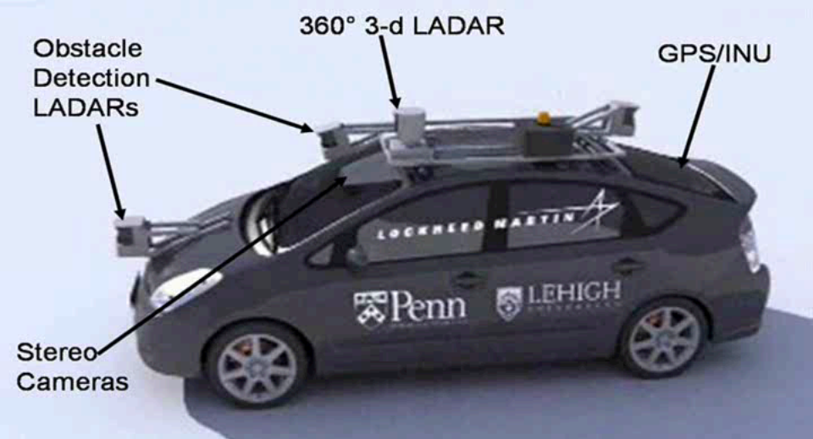
Autonomous Car Sensors
DCS310 @ SYSU

Slide 48
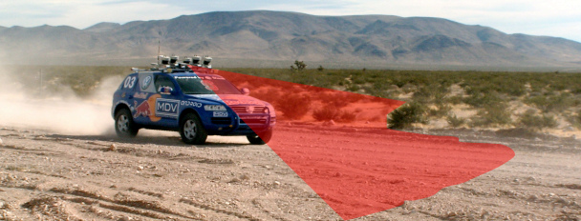
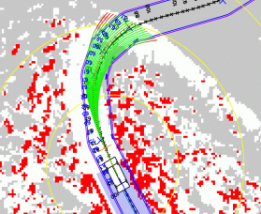
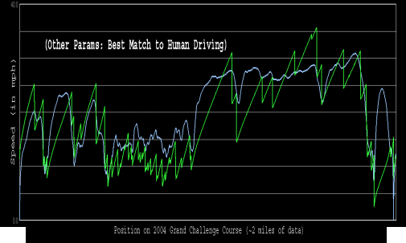
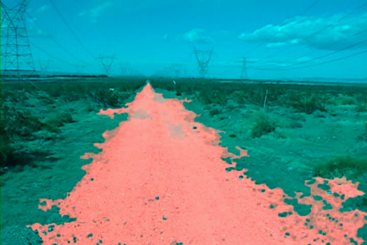
Autonomous Car Technology
Path Planning
Laser Terrain Mapping
Learning from Human Drivers
Sebastian
Stanley
Adaptive Vision
DCS310 @ SYSU

Slide 49
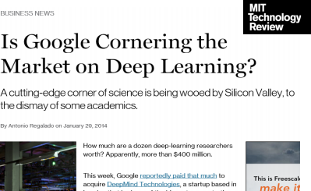
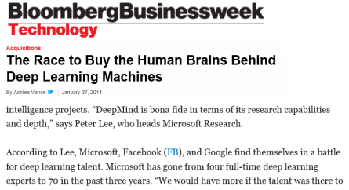
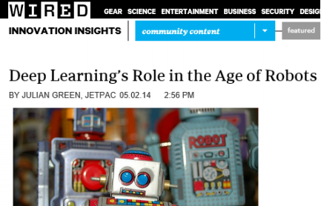

Deep Learning in the Headlines
DCS310 @ SYSU

Slide 50





Deep Neural Networks on Face Images
object models
object parts
(combination of edges)
edges
pixels
DCS310 @ SYSU

Slide 51

Scene Labeling via Deep Learning
DCS310 @ SYSU

Slide 52


Machine Learning in
Automatic Speech Recognition
A Typical Speech Recognition System
ML used to predict of phone states from the sound spectrogram
Deep learning has state-of-the-art results
# Hidden Layers | 1 | 2 | 4 | 8 | 10 | 12
Word Error Rate % | 16.0 | 12.8 | 11.4 | 10.9 | 11.0 | 11.1
Baseline GMM performance = 15.4% [Zeiler et al. “On rectified linear units for speech recognition” ICASSP 2013]
21
DCS310 @ SYSU

Slide 53

Impact of Deep Learning in Speech Technology
DCS310 @ SYSU

Slide 54
Types of Learning
DCS310 @ SYSU

Slide 55
Types of Learning
Supervised (inductive) learning
– Given: training data + desired outputs (labels)
Unsupervised learning
– Given: training data (without desired outputs)
Semi-supervised learning
– Given: training data + a few desired outputs
Reinforcement learning
– Rewards from sequence of actions
DCS310 @ SYSU

Slide 56

Supervised Learning: Regression
• Given (x1, y1 ), (x2, y2 ), ..., (xn, yn )
• Learn a function f(x) to predict y given x
– y is real-valued == regression
9
8
7
6
5
4
3
2
1
0
(1,000,000 sq km)
September Arctic Sea Ice Extent
1970 1980 1990 2000 2010 2020
Year
DCS310 @ SYSU

Slide 57

Supervised Learning: Classification
Given (x1, y1 ), (x2, y2 ), ..., (xn, yn )
• Learn a function f(x) to predict y given x
– y is categorical == classification
DCS310 @ SYSU

Slide 58

















Unsupervised Learning
Given x1, x2, ..., xn (without labels)
Output hidden structure behind the x’s
– E.g., clustering
DCS310 @ SYSU

Slide 59

Unsupervised Learning
Genomics application: group individuals by genetic similarity
Genes
Individuals
DCS310 @ SYSU

Slide 60






Unsupervised Learning
Organize computing clusters
Social network analysis
Image credit: NASA/JPL-Caltech/E. Churchwell (Univ. of Wisconsin, Madison)
Market segmentation
Astronomical data analysis
DCS310 @ SYSU

Slide 61


Unsupervised Learning
Independent component analysis – separate a combined signal into its original sources
DCS310 @ SYSU

Slide 62
Reinforcement Learning
Given a sequence of states and actions with (delayed) rewards, output a policy
– Policy is a mapping from states → actions that tells you what to do in a given state
Examples :
– Credit assignment problem
– Game playing
– Robot in a maze
– Balance a pole on your hand
DCS310 @ SYSU

Slide 63

The Agent-Environment Interface
DCS310 @ SYSU

Slide 64

Reinforcement Learning
AlphaGo vs. 李世石
DCS310 @ SYSU

Slide 65

Inverse Reinforcement Learning
Extract the reward function from an agent's observed behavior.
Stanford Autonomous Helicopter
DCS310 @ SYSU

Slide 66
Motivating Challenges
Scalability
High Dimensionality
Heterogeneous and Complex Data
Data Ownership and Distribution
Non-traditional Analysis

Slide 67
Machine Learning and Data Mining
Conferences
  KDD, WWW, SIGIR, WSDM, CIKM
  ICML, NeurIPS (NIPS), ICLR
Journals
  TKDE, TOIS, TKDD, IP&M
  JMLR etc.

